Slide 1



X
Final Task
Business Intelligence
Presented by
Muhammad Wahfiuddin Pradiwa

Slide 2



Muhammad
Wahfiuddin Pradiwa
Insert Your Experience
Universitas Diponegoro
Bachelor of Economics
MySkill Indonesia
Fresh graduate majoring in economics, Diponegoro University. Really interested in data analytics and business analyst with good presentation and teamwork skills.
Fullstack Intensive Bootcamp Data Analysis
Kalbe Nutritionals X Rakamin Academy
Data Engineer-Project Based Virtual Intern

Slide 3
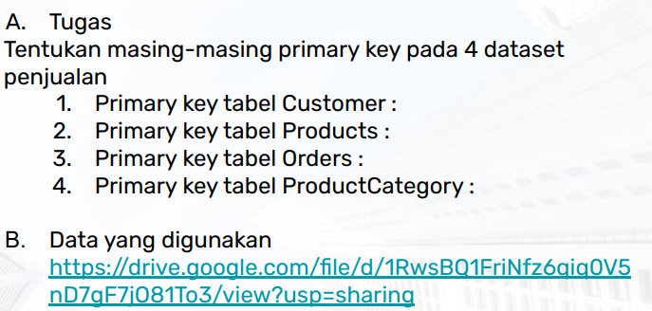
Case 1

Slide 4
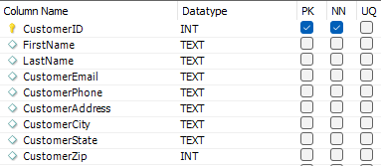
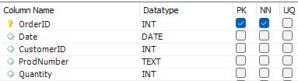


Solution 1
Primary key bersifat unik, dan menjadi kolom kunci dalam table. Primary key setiap table adalah CustomerID, OrderID, CategoryID, dan ProdNumber
Customers Table
Orders Table
ProductCategory Table
Products Table

Slide 5
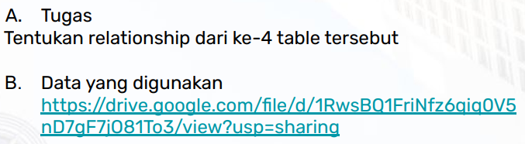
Case 2

Slide 6
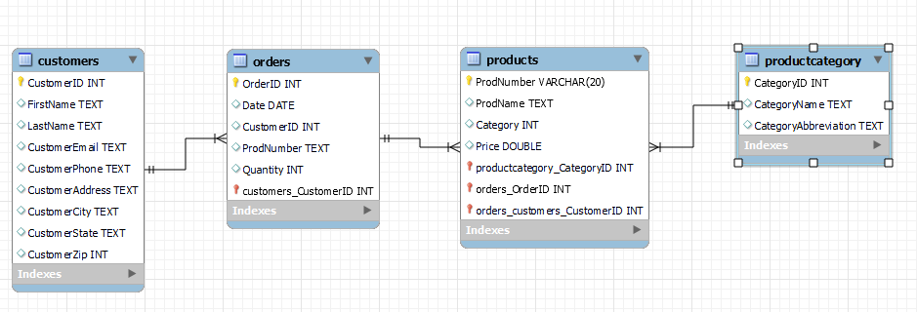
Solution 2

Slide 7
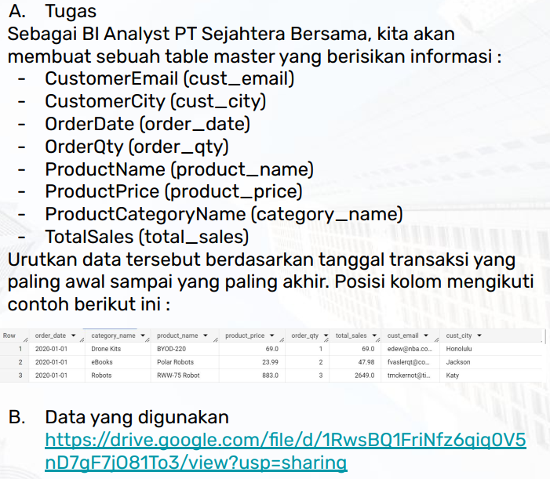
Case 3

Slide 8
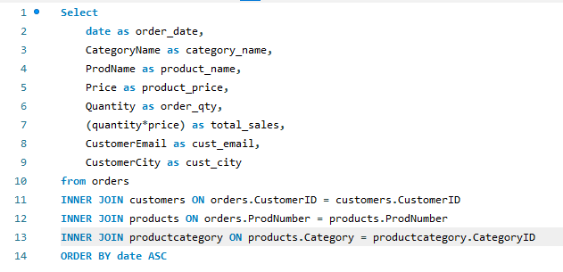
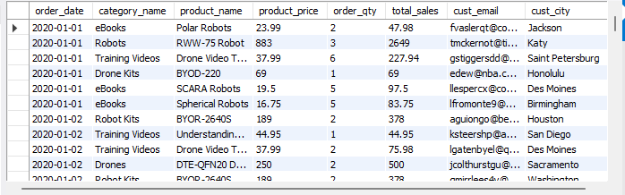
Solution 3

Slide 9
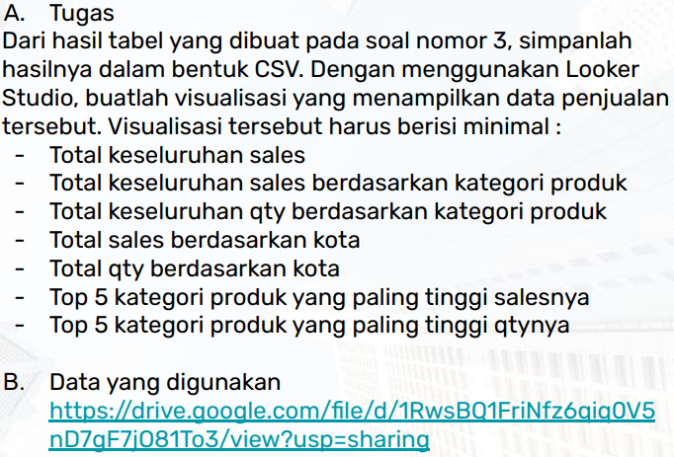
Case 4

Slide 10
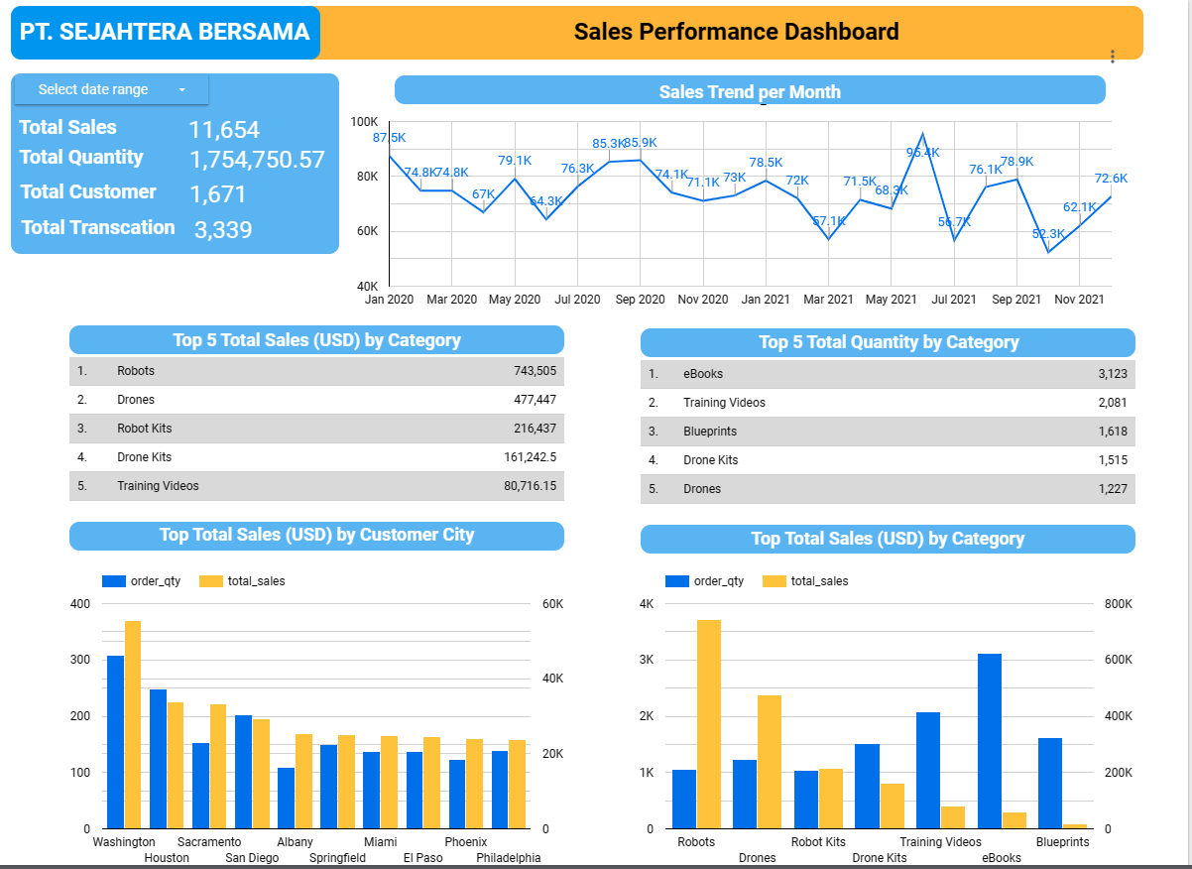
Solution 4

Slide 11
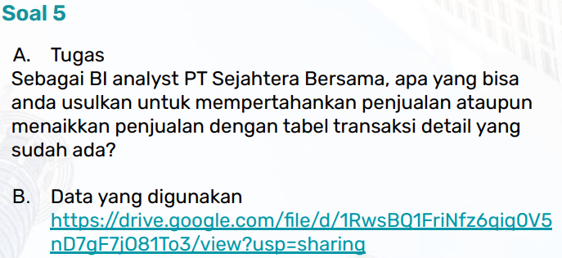
Case 5

Slide 12
Solution 5
Suggestion as BI Analyst of PT. Sejahtera Bersama to maintain or increase sales performance
There are 1671 customers and 3339 transaction that indicates repeat order consumer behaviour. To maintain this behaviour I suggest loyalty point program and customer relation/service that helpful. In other side we need to increase customers number by create referral programs and promotion event (discount, cashback).
Maintain stock and maintain promotion for category that has high sales compared to quantity (Robots and Drones)
Yearly trend, 2021 is decreased than 2020. We should evaluate this condition and determine which point should be optimized.
Focus for promotion in top sales city

Slide 13
Insert Your Link Here
https://lookerstudio.google.com/reporting/1f30bc50-30cb-4c57-8277-5b9a1f60c83c
https://github.com/pradiwawahfiuddin/Data_Portfolio.git

Slide 14
Video Presentation Here
https://drive.google.com/drive/folders/1eE4nstRgBtrMldZE-URDVaTIGYR7mvfC?usp=sharing

Slide 15
Thank You
X

